Slide 1
SQL- PROJECT
MySQL course- Besant Technologies
By-Lakshmi Kambampati
Email-Lakshmi.nk996@gmail.com

Slide 2
SQL
Structured query language(SQL) is the programming language used to maintain and manipulate relational databases.
Relational databases are the databases which store data in the form of tables and follow the E.F Codd rules.
In these we analyze the sample super store dataset with the help of SQL
The sample super store dataset can be downloaded from the below link for reference.
Link - https://www.kaggle.com/datasets/bravehart101/sample-supermarket-dataset

Slide 3
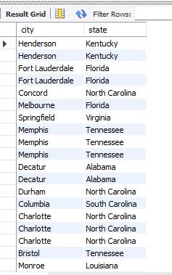
SELECT 1.Write a SQL query to retrieve the city and state for all records where the region is 'South’. Query: Select city , state from mart where region='south’; Output :

Slide 4
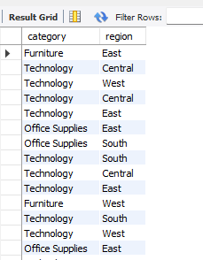
CONDITION: 2.Write a SQL query which product categories and regions have recorded sales greater than 3000? Query: Select category , region from mart where sales>3000; Output:

Slide 5
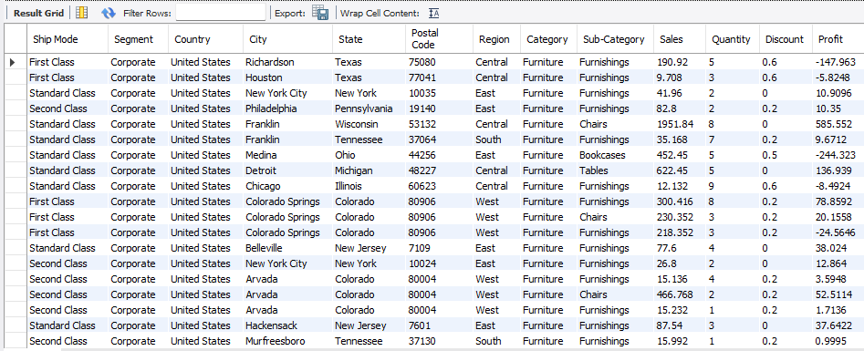
AND: 3.Write a SQL query which records in the belong to the Corporate segment and the Furniture category? Query: Select * from mart where Segment='corporate' and category='furniture'; Output:

Slide 6
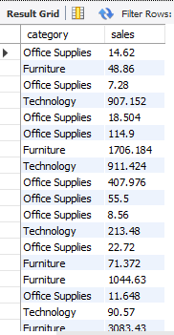
OR: 4.Write a SQL query to select category, sales from mart where region='east' or region='west'; Query: Select category , sales from mart where region='east' or region='west’; Output:

Slide 7
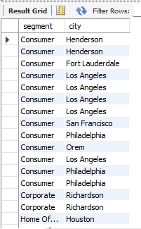
IN: 5. Which segments and cities are associated with the Furniture and Technology categories? Query: Select segment , city from mart where category in ('furniture’ , 'technology’); Output:

Slide 8
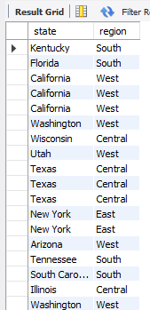
BETWEEN: 6. Which states and regions have sales between 301 and 2999? Query: Select state , region from mart where sales between 301 and 2999; Output:

Slide 9

COUNT: 7. Write a query how many records have sales less than 2000? Query: Select count(*) from mart where sales<2000; Output:

Slide 10
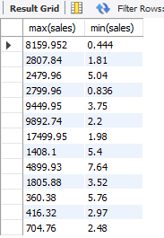
GROUPBY: 8. What are the maximum and minimum sales in each state within the Central region? Query: Select max(sales),min(sales) from mart where region='central’ group by state; Output:

Slide 11

HAVING: 9. How many records are there in each category that has at least 4 entries? Query: Select count(*) from mart group by category having count(*)>=4; Output:

Slide 12
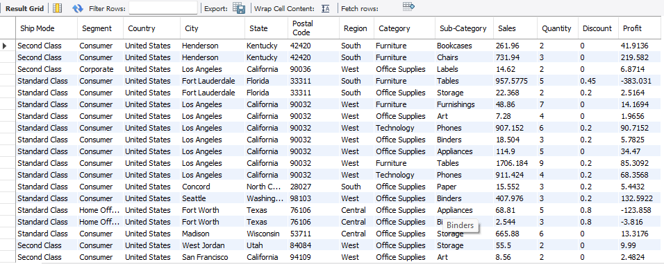
SUBQUERY: 10. Which records belong to categories that are present in the state of California? Query: Select * from mart where category in ( Select category from mart where state=‘ California '); Output:

Slide 13
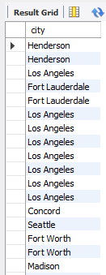
SINGLE ROW SUBQUERY: 11. Which cities are in regions where the segment is 'Consumer' according to the mart2 table? Query: Select city from mart where region in( Select region from mart2 where Segment=‘Consumer’); Output:

Slide 14
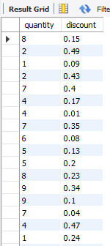
MULTI ROW SUBQUERY: 12. What are the quantities and discounts for cities located in the state of New York? Query: Select quantity , discount from mart2 where city not in (Select city from mart where state=‘ New York ’ ); Output:

Slide 15

NESTED SUBQUERY: 13. Which country and state have the lowest sales values? Query: Select country , state from mart where sales in(Select min(sales) from mart where sales in(Select min(sales) from mart)); Output:

Slide 16
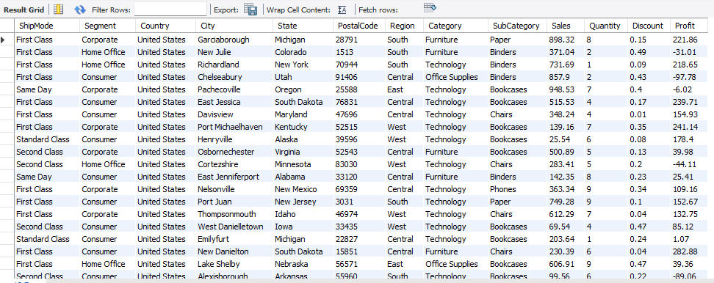
RELATIONS: 14. Which records in mart2 belong to categories found in the East region in the mart table? Query: Select * from mart2 where category in (Select category from mart where region='east’); Output:

Slide 17

ALL: 15. Which categories, sales, and quantities have sales greater than all sales in the state of New York? Query: Select Category , Sales , Quantity from mart where sales>All( Select sales from mart where state=‘ New York ’ ); Output:

Slide 18
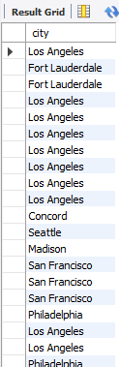
LIKE: 16. Which cities are in states containing the letter 'i' and belong to segments with profits less than 30? Query: Select city from mart where state like ‘% i %' and segment in( Select segment from mart where profit<30); Output:

Slide 19
NOT NULL: 17. Which countries and states have a discount and a profit greater than all profits in the Furniture category? Query: Select country, state from mart where discount is not null and profit > All ( Select profit from mart where category = 'furniture' ); Output:

Slide 20
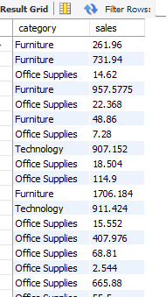
ANY: 18. List the categories and their sales where the quantity sold is less than at least one of the quantities sold in the 'south' region. Query: Select category , sales from mart where quantity<Any( Select Quantity from mart where region='south’); Output:

Slide 21
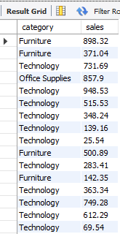
RELATIONS: 19. Which categories and sales in mart2 are in regions where sales in mart match profits in mart with no discount? Query: Select category , sales from mart2 where region in( Select region from mart where sales in(select profit from mart where discount=0)); Output:

Slide 22
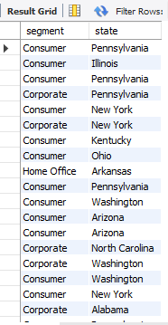
SUBQUERY: 20. Which segments and states have sales equal to the profit of the Furniture category? Query: Select segment , state from mart where sales in(Select profit from mart where category='furniture’); Output:

Slide 23
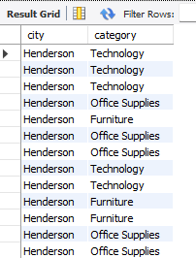
CROSS JOIN: 21. What are all combinations of cities from mart and categories from mart2? Query: Select e1.city,e2.category from mart e1,mart2 e2; Output:

Slide 24
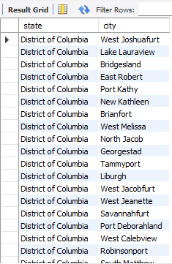
INNER JOIN: 22. Which states from mart and cities from mart2 have matching city and state names? Query: Select e1.state,e2.city from mart e1, mart2 e2 where e1.city=e2.state; Output:

Slide 25
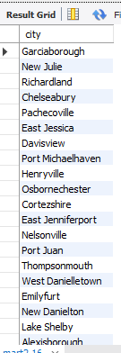
SELF JOIN: 23. Which cities in mart2 are located in regions that also exist in mart? Query: Select city from mart2 where region in( Select region from mart where mart . region=mart2 . region); Output:

Slide 26
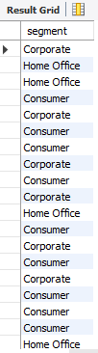
EXISTS: 24. Which segments in mart2 correspond to categories that are found in the mart table? Query: Select segment from mart2 where exists( Select Category from mart where mart2 . category=mart . category); Output:

Slide 27
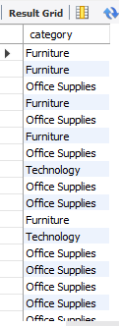
NOT EXISTS: 25. Which categories in mart do not have any matching cities in mart2? Query: Select category from mart where not exists( Select city from mart2 where mart . city=mart2 . city); Output:

